Slide 1


Introduction to Applied Deep Learning
CS129.18 & CSCI214
Hadrian Paulo Lim, MS

Slide 2
SkyNet is Here?!
What’s this “Deep Learning” I keep hearing about?
Creating My First Neural Network
Introduction to AI
Deep Learning Fundamentals
Perceptrons and Multi-Layer Perceptron (MLPs)
How does AI see?
How does AI remember?
What Do I Do After Today?
Convolutional Neural Networks
Recurrent Neural Networks
Recommendations
Notes:
This outline is based on the Minto Principle https://medium.com/lessons-from-mckinsey/the-pyramid-principle-f0885dd3c5c7. Use when applicable.
Provide section titles (blue box) and any subtitle if any (grey box).
If you want to change OUTLINE to AGENDA, go to Slide Menu, choose Edit Master, and change from there.

Slide 3
Introduction to AI
Machine Learning
Natural Language Processing
Deep Learning
Artificial Intelligence
Computer Vision
Rule-based Systems
Symbolic Learning
AI Intro | Deep Learning | My First Neural Net | ConvNets | Recurrent Nets | Recommendations

Slide 4
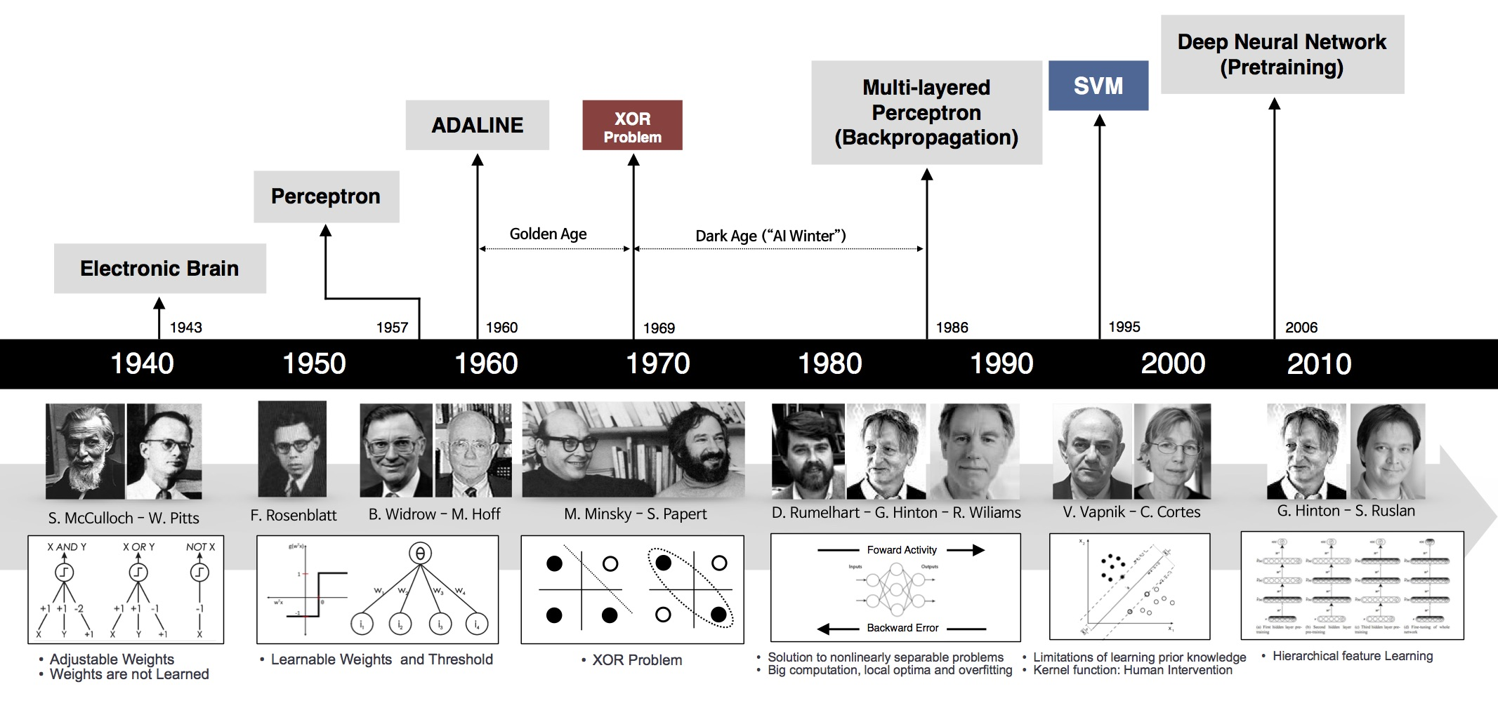
Introduction to AI
History of Deep Learning (It’s not that new)
AI Intro | Deep Learning | My First Neural Net | ConvNets | Recurrent Nets | Recommendations

Slide 5
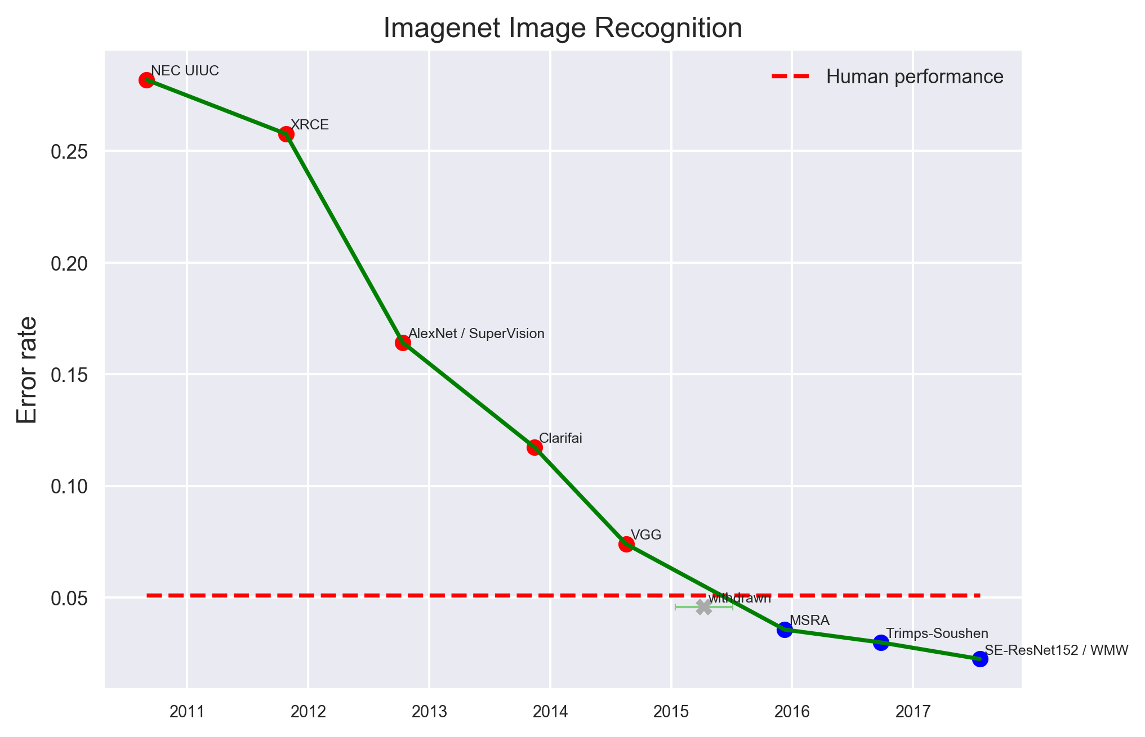
Introduction to AI
Deep Learning Has Exceeded Human-level Performance
AI Intro | Deep Learning | My First Neural Net | ConvNets | Recurrent Nets | Recommendations

Slide 6
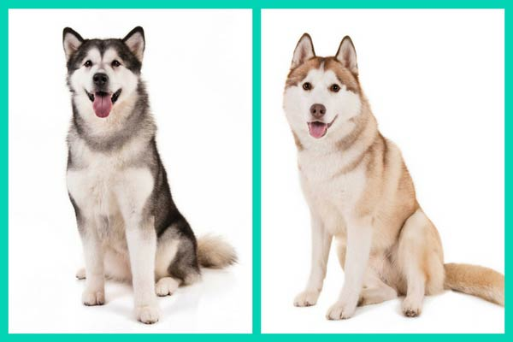
Introduction to AI
Siberian Husky or Alaskan Malamute?
AI Intro | Deep Learning | My First Neural Net | ConvNets | Recurrent Nets | Recommendations

Slide 7
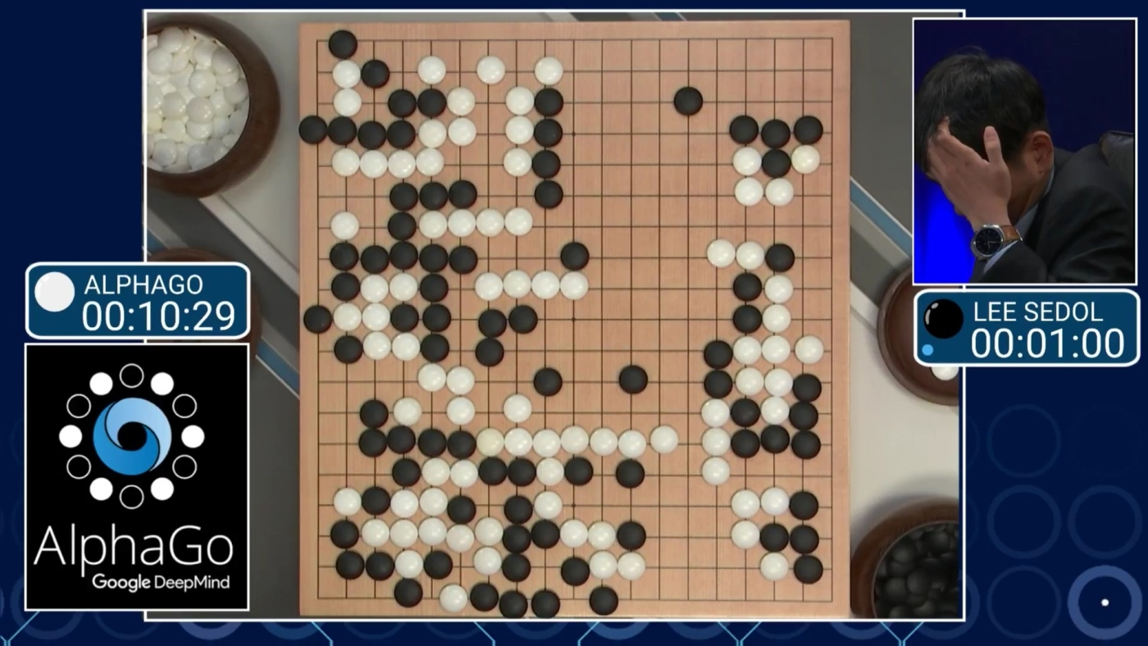
Introduction to AI
Deep Learning Has Beaten Humanity’s Best at Go
AI Intro | Deep Learning | My First Neural Net | ConvNets | Recurrent Nets | Recommendations

Slide 8
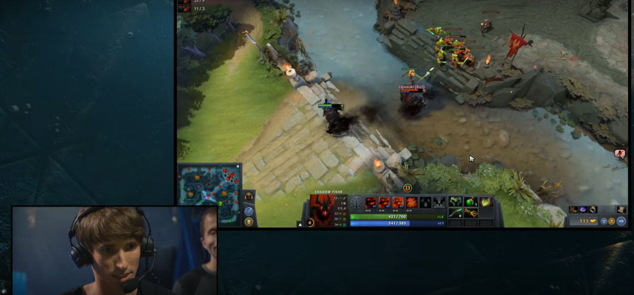
Introduction to AI
Deep Learning is about to Dominate eSports
AI Intro | Deep Learning | My First Neural Net | ConvNets | Recurrent Nets | Recommendations

Slide 9
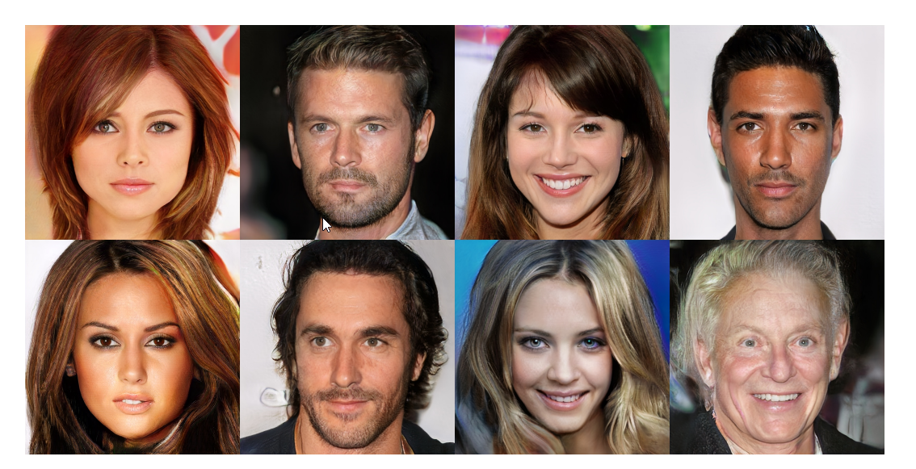
Introduction to AI
Deep Learning to Create Virtual Celebrities
AI Intro | Deep Learning | My First Neural Net | ConvNets | Recurrent Nets | Recommendations

Slide 10
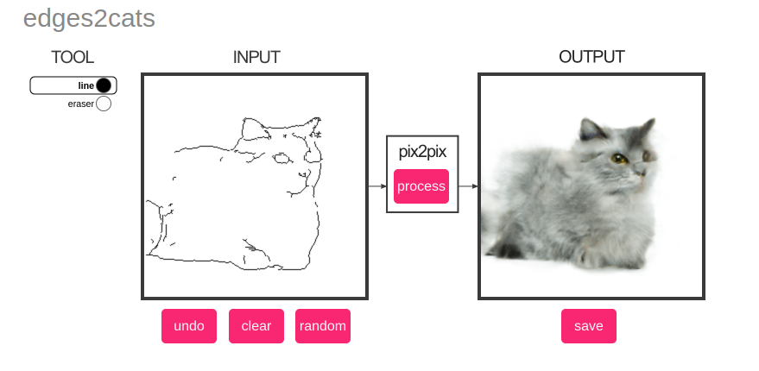
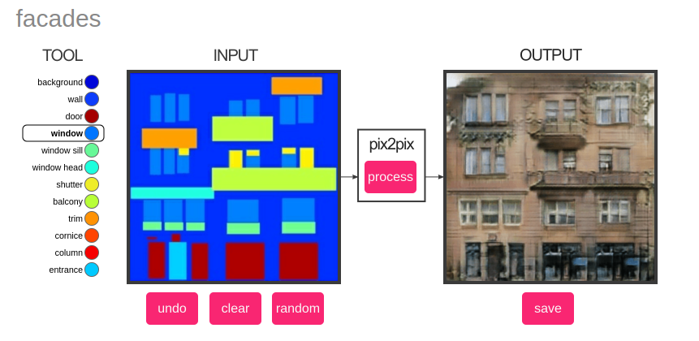
Introduction to AI
Deep Learning to Create Virtually Anything
https://affinelayer.com/pixsrv/
AI Intro | Deep Learning | My First Neural Net | ConvNets | Recurrent Nets | Recommendations

Slide 11
Fundamentals of Deep Learning

Slide 12
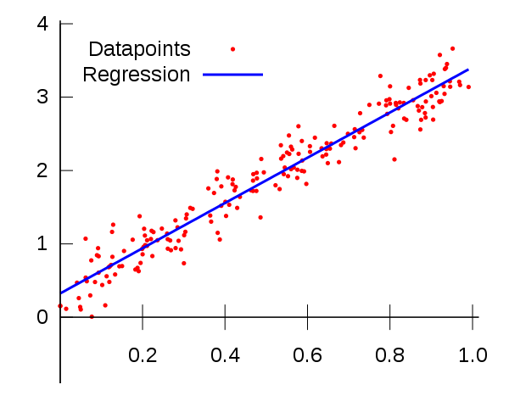
Deep Learning Fundamentals
Linear Regression
Y = m_{1..n}X_{1..n} + b
AI Intro | Deep Learning | My First Neural Net | ConvNets | Recurrent Nets | Recommendations

Slide 13
Deep Learning Fundamentals
Perceptron and Linear Regression
Y = m_{1..n}X_{1..n} + b
X₁
m_{1..3} X_{1..3}
ƒ(x) = x
Activation Function
X₂
ƒ
Y
X₃
b
Perceptron Model
AI Intro | Deep Learning | My First Neural Net | ConvNets | Recurrent Nets | Recommendations

Slide 14
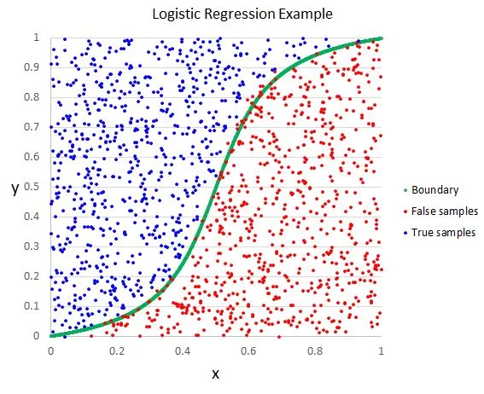
Deep Learning Fundamentals
Perceptron and Logistic Regression
Y = σ(m_{1..n}X_{1..n} + b)
ƒ(x) = σ(x)
= 1 / (1+ e^{-x})
X₁
m_{1..3} X_{1..3}
X₂
ƒ
Y
X₃
b
AI Intro | Deep Learning | My First Neural Net | ConvNets | Recurrent Nets | Recommendations

Slide 15
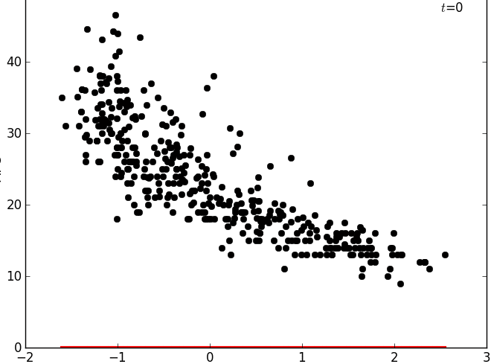
Deep Learning Fundamentals
How Does a Perceptron Learn from Data?
How do you learn in real life?
There’s a mechanism (like tests and exams) that tells you if you’re right or wrong, and how many errors you’ve made.
Machine Learning works the same way
There’s also a mechanism or function that tells the perceptron on how wrong it is.
Loss or Cost Function (J)
The Loss or Cost function calculates the error values and tells the perceptron how to improve. The errors should be as low as possible.
Correcting itself, slowly but surely.
AI Intro | Deep Learning | My First Neural Net | ConvNets | Recurrent Nets | Recommendations

Slide 16


Deep Learning Fundamentals
How Does a Perceptron Correct Itself?
The Loss Function, Visualized
The Optimizer as a Coach
If we plot all the possible values of the Loss function, or J, it looks like a mountain. Remember that we want the smallest value of J.
An optimization function or algorithm, tells the perceptron where to face, and how large its steps (or change in parameters) will be.
AI Intro | Deep Learning | My First Neural Net | ConvNets | Recurrent Nets | Recommendations

Slide 17
Deep Learning Fundamentals
Choosing (Some) Loss Functions
General Problem Type | Specific Problem Type | Loss Function | Example
Classification Choosing from a limited number of labels | For binary classification | Binary Cross Entropy | Yes or No Cat or Dog Food or not Food
 | For multiple label classification | Categorical Cross Entropy | Multiple Food Classification
Regression Predicting a value from -∞ to ∞. | Outlier sensitive | Mean Squared Error | Outliers are important
 | Outlier Insensitive | Mean Absolute Error | Noisy data
AI Intro | Deep Learning | My First Neural Net | ConvNets | Recurrent Nets | Recommendations

Slide 18


Deep Learning Fundamentals
Choosing Optimization Functions
AI Intro | Deep Learning | My First Neural Net | ConvNets | Recurrent Nets | Recommendations

Slide 19


Deep Learning Fundamentals
What about the Activation Functions or ƒ for the Perceptron?
Choose the sigmoid function when you’re only discriminating between two choices.
Sigmoid (σ)
SIGMOID
Choose the softmax function when you’re classifying with multiple labels.
Softmax
SOFTMAX
Choose the linear function when you’re trying to predict for values in regression problems.
Linear
LINEAR
AI Intro | Deep Learning | My First Neural Net | ConvNets | Recurrent Nets | Recommendations

Slide 20
Deep Learning Fundamentals
Always standardize your data before using the Perceptron or any Deep Learning Model.
Most Important Tip
AI Intro | Deep Learning | My First Neural Net | ConvNets | Recurrent Nets | Recommendations

Slide 21
Pima Indians Diabetes Prediction Exercise

Slide 22
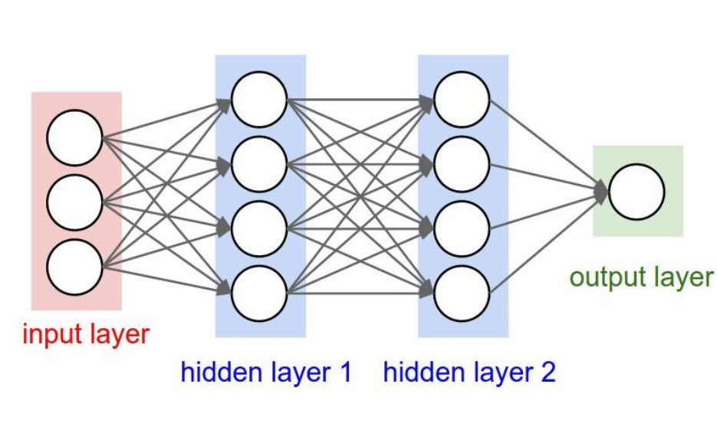
Perceptrons and Multi-Layer Perceptrons
Perceptrons are only Linear Models
As discussed earlier, there’s no difference in generalized linear models and the perceptron.
Multi-Layer Perceptrons (MLPs)
To create complex models for “harder” classification and regression problems, perceptrons can be stacked to induce non-linearities.
“Deep” Learning = Deep Hierarchy
Given enough data and a complex model, Deep Learning works because the model will “learn” the innate properties and relationships of the data.
AI Intro | Deep Learning | My First Neural Net | ConvNets | Recurrent Nets | Recommendations

Slide 23
Tensorflow Playground
https://playground.tensorflow.org

Slide 24
Perceptrons and Multi-Layer Perceptrons
Hidden Layers should default to ReLU as the activation function.
Network Design generally follows the “Wide to Deep” Guideline, where neurons per layer follow 2^{n}
The final layer is dependent on your prediction problem.
Rules of Thumb
AI Intro | Deep Learning | My First Neural Net | ConvNets | Recurrent Nets | Recommendations

Slide 25
Pima Indians Diabetes Prediction Exercise 2

Slide 26
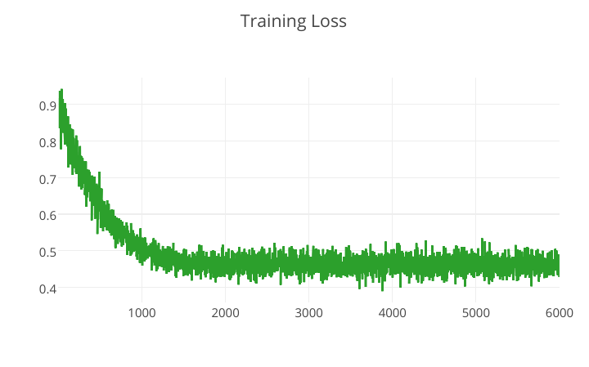
Perceptrons and Multi-Layer Perceptrons
Gaining Intuition for the Learning Process
Noisy Train and Loss Functions?
This is caused by the batch size in your hyperparameters. Batch size indicates how many sampled rows will be used by your model during each training step or “epoch”.
Getting Smooth Graphs
Just indicate the batch size to be equal to your number of training records.
Why Not Do This In The 1st Place?
Unfortunately, not all computers have the capacity to store everything in memory. Interestingly, it’s also been observed that smaller batch sizes can lead to less overfitting.
AI Intro | Deep Learning | My First Neural Net | ConvNets | Recurrent Nets | Recommendations

Slide 27
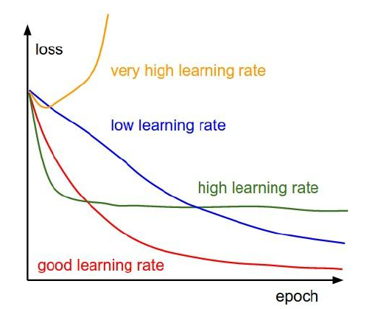
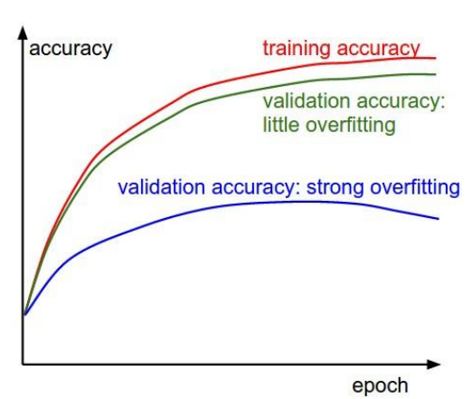
Perceptrons and Multi-Layer Perceptrons
Gaining Intuition for the Learning Process
AI Intro | Deep Learning | My First Neural Net | ConvNets | Recurrent Nets | Recommendations

Slide 28
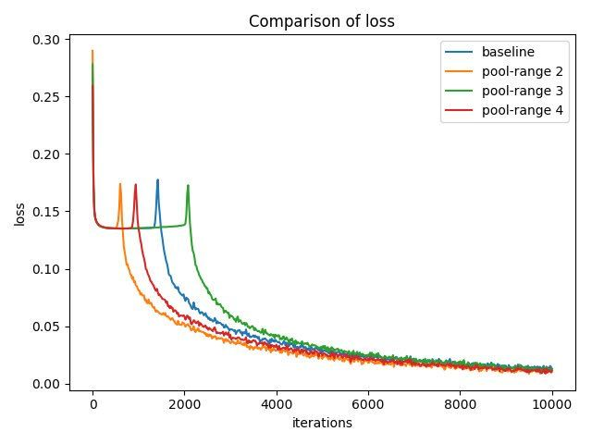
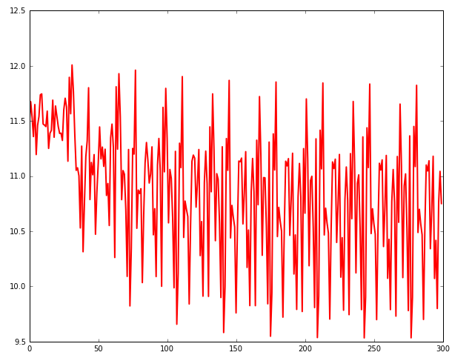
Perceptrons and Multi-Layer Perceptrons
What If My Loss Function is Weird? (WTF?)
AI Intro | Deep Learning | My First Neural Net | ConvNets | Recurrent Nets | Recommendations

Slide 29
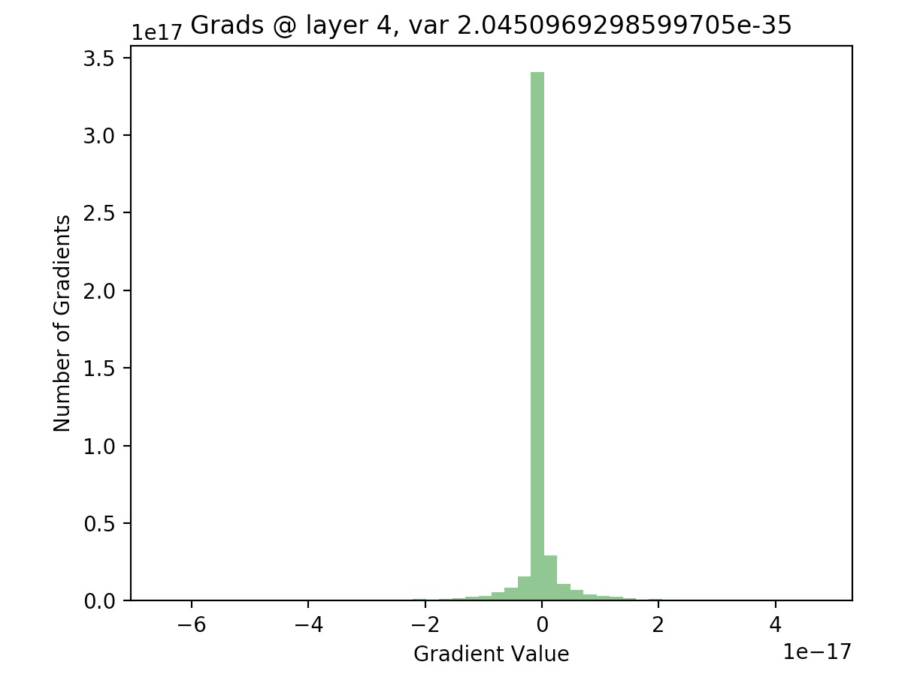
Perceptrons and Multi-Layer Perceptrons
Designing Better Models: BatchNorm Layer
Vanishing or Exploding Gradients
Deep Neural Networks have an innate problem of vanishing or exploding gradients. This just means that the weights in the network get too big or small.
Normalize Gradients Per Layer
As with standardizing the inputs, it was discovered that standardizing the gradients per layer performed really well.
BatchNorm to the Rescue!
BatchNorm was devised as a Normalization layer that is usually placed after each dense or fully connected layer.
AI Intro | Deep Learning | My First Neural Net | ConvNets | Recurrent Nets | Recommendations

Slide 30
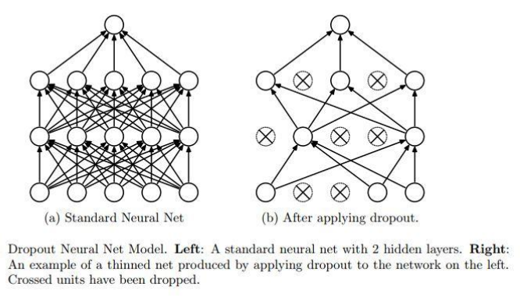
Perceptrons and Multi-Layer Perceptrons
Designing Better Models: Dropout
Oversaturating on Some Neurons
Surprisingly when training neural networks, some neurons are more influential or have greater weights than the others.
Randomly Turning On and Off
Dr. Hinton, the Father of Deep Learning, had an idea to randomly drop or turn off neurons during training.
It’s Time to Dropout!
Dropout enables the model to use other neurons in the network during training. Rule of thumb is to add Dropout after BatchNorm, with a probability rate of 0.2.
AI Intro | Deep Learning | My First Neural Net | ConvNets | Recurrent Nets | Recommendations

Slide 31
Perceptrons and Multi-Layer Perceptrons
BatchNorm and Dropout allow us to add lots of neurons and layers.
Always apply BatchNorm before Dropout.
Though BatchNorm and Dropout, prevent overfitting, these may also induce models to underfit often; Models may take longer to train.
Some More Tips
AI Intro | Deep Learning | My First Neural Net | ConvNets | Recurrent Nets | Recommendations

Slide 32
MNIST Digits Exercise 3

Slide 33

Convolutional Neural Networks
What is a Convolutional Neural Network?
AI Intro | Deep Learning | My First Neural Net | ConvNets | Recurrent Nets | Recommendations

Slide 34

Convolutional Neural Networks
What is a Convolution?
AI Intro | Deep Learning | My First Neural Net | ConvNets | Recurrent Nets | Recommendations

Slide 35

Convolutional Neural Networks
What do the Filters in Convolutions Learn?
AI Intro | Deep Learning | My First Neural Net | ConvNets | Recurrent Nets | Recommendations

Slide 36
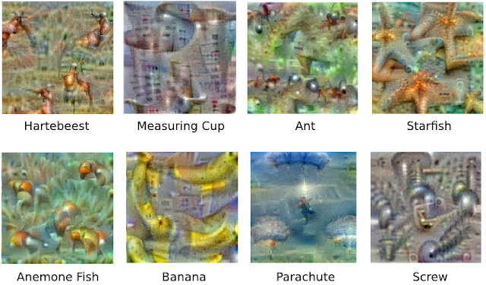
Convolutional Neural Networks
What do the Filters in Convolutions Learn?
AI Intro | Deep Learning | My First Neural Net | ConvNets | Recurrent Nets | Recommendations

Slide 37
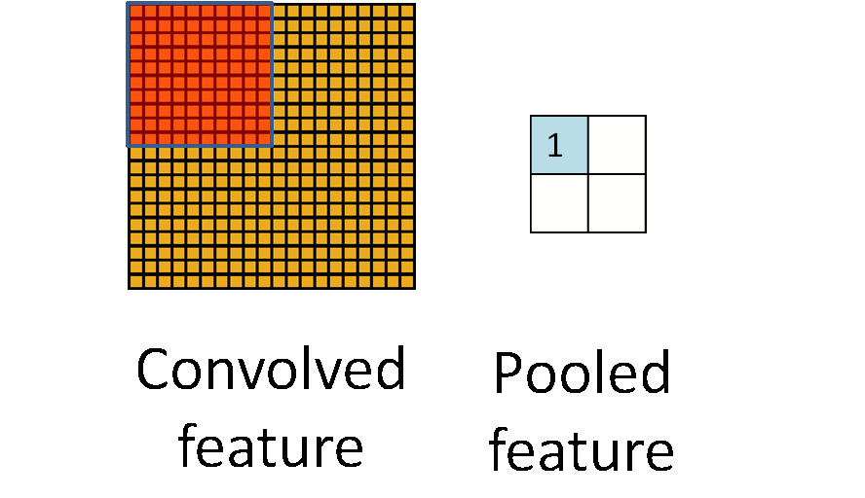
Convolutional Neural Networks
What is Pooling?
AI Intro | Deep Learning | My First Neural Net | ConvNets | Recurrent Nets | Recommendations

Slide 38
Convolutional Neural Networks
Is there a Pattern for Creating CNNs?
Input
* M
* N
?
Conv2D
MaxPool
* K
Dense
N >= 0 (usually <= 3)
M >= 0
K >= 0 (usually < 3)
Dense
AI Intro | Deep Learning | My First Neural Net | ConvNets | Recurrent Nets | Recommendations

Slide 39
Convolutional Neural Networks
Keep filters or kernel sizes small and uniform for the convolutions; Uniform strides and pool sizes for pooling operations.
Ex. Uniformly just (2 rows, 2 columns) as your filter.
Follow the “Wide to Deep” rule of thumb, even for convolutional operations.
CNN Tips
AI Intro | Deep Learning | My First Neural Net | ConvNets | Recurrent Nets | Recommendations

Slide 40
MNIST Digits Exercise 4

Slide 41
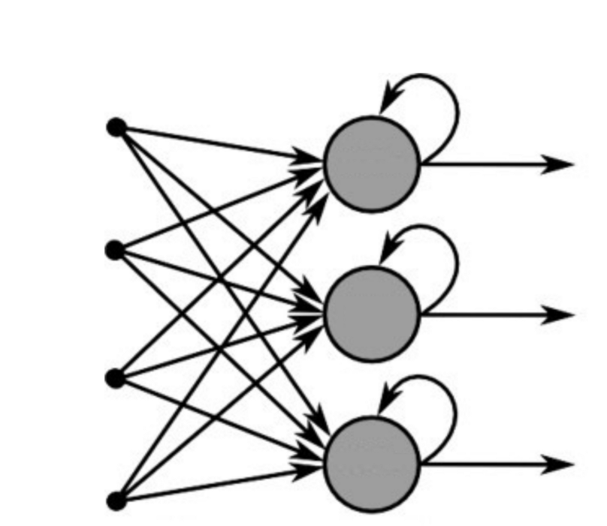

Recurrent Neural Networks
What’s a Recurrent Neural Network?
AI Intro | Deep Learning | My First Neural Net | ConvNets | Recurrent Nets | Recommendations

Slide 42
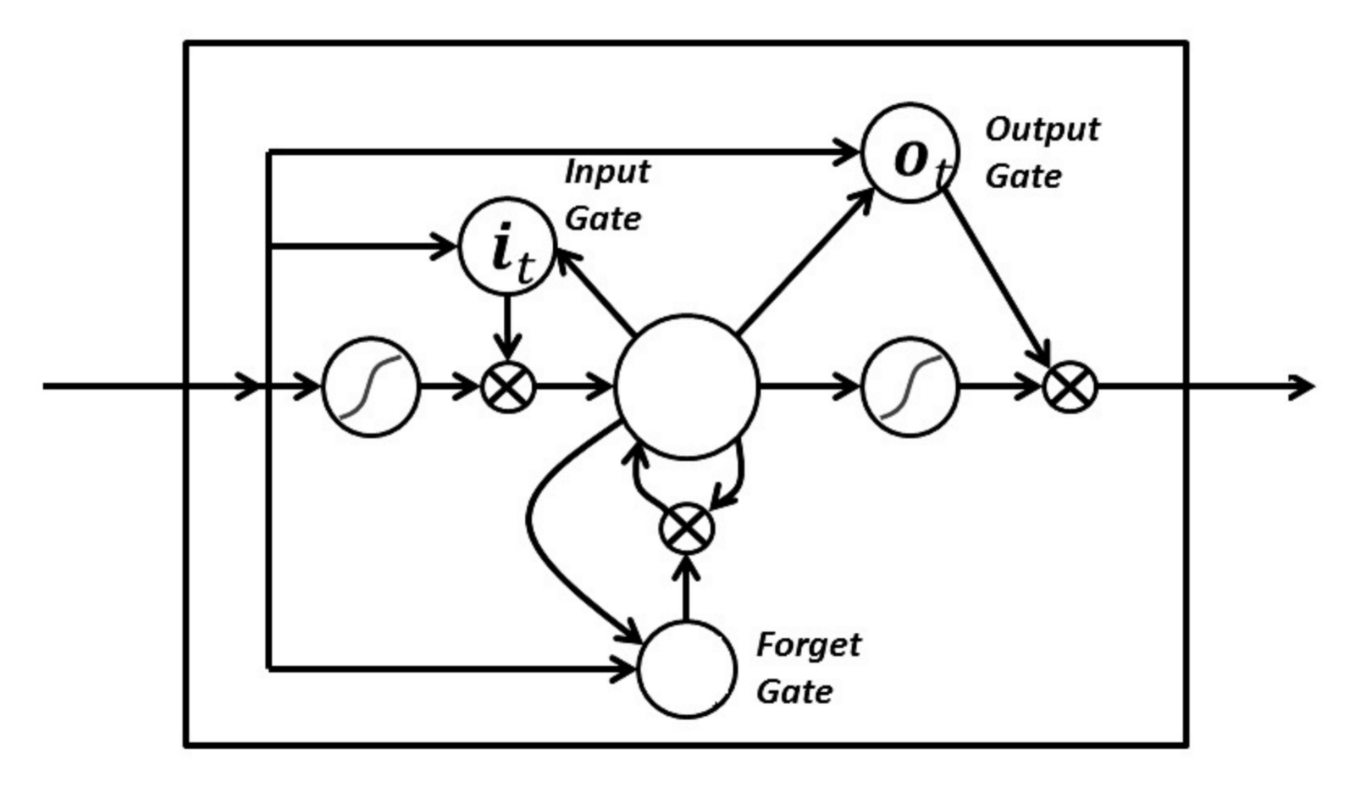
Recurrent Neural Networks
The Long Short Term Memory Neuron (LSTM)
AI Intro | Deep Learning | My First Neural Net | ConvNets | Recurrent Nets | Recommendations

Slide 43



Recurrent Neural Networks
Applications of RNNs and LSTMs
RNNs work incredibly well with complex datasets involving multivariate data for regression problems.
REGRESSION
Varying sequence classification and regression problems are also areas where RNNs perform extremely well.
SEQUENCES
Natural Language Processing problems, such as language translations and language understanding, had breakthroughs with RNNs
NATURAL LANGUAGE PROCESSING
AI Intro | Deep Learning | My First Neural Net | ConvNets | Recurrent Nets | Recommendations

Slide 44
Recurrent Neural Networks
Extending the Bible’s Genesis with RNNs
Input:
“brother is dead, and he alone is left. I”
Prediction:
“t will i shall be the firstborn, who shall be over the flock.
[19:14] and said to his brothers, "what i have do not be abraming for the flock.
[19:14] and the lord has serent there whose the lord has ot the land of egypt and the lord has other sons and daughters.
[10:16] then he said, "i am the land of egypt the camels and the waters of the land of egypt and the lord has other sons and daughters.”
AI Intro | Deep Learning | My First Neural Net | ConvNets | Recurrent Nets | Recommendations

Slide 45
Recurrent Neural Networks
Extending Game of Thrones Book 6 with RNNs
Input:
“Tyrion”
Prediction:
Tyrion could hear Lord Aemon’s coughing. “I miss for it. Why did you proper?”
“I feared Master Sansa, Ser,” Ser Jaime reminded her. “She Baratheon is one of the crossing. The second sons of your onion concubine.”
Lady Donella length of a longsword, the hair that went ready to climb side from her. And all between them were belaquo bonebreaker and the night’s watch ride in their room. Only he could not look at them, even others sure. “How could you leave the world?”
“Some must, for you,” a woman’s voiced up lazily. “Gods, Reek.”
AI Intro | Deep Learning | My First Neural Net | ConvNets | Recurrent Nets | Recommendations

Slide 46
Convolutional Neural Networks
The “Wide to Deep” rule of thumb still applies.
RNNs are incredibly long and computationally expensive to train.
RNN Tips
AI Intro | Deep Learning | My First Neural Net | ConvNets | Recurrent Nets | Recommendations

Slide 47
SUMMARY
RECOMMENDATIONS
Step up your Deep Learning game! Take the free Fast AI online course and acquire industry-grade skills: http://course.fast.ai/
Don’t know how to code yet?
Either learn Python fast: https://learnpythonthehardway.org/python3/intro.html
Get an intro to CS course through Harvard’s CS50: https://www.edx.org/course/cs50s-introduction-computer-science-harvardx-cs50x
AI Intro | Deep Learning | My First Neural Net | ConvNets | Recurrent Nets | Recommendations

